Slide 1

CLASSIFICATION OF DATA SET USING PYTHON

Slide 2
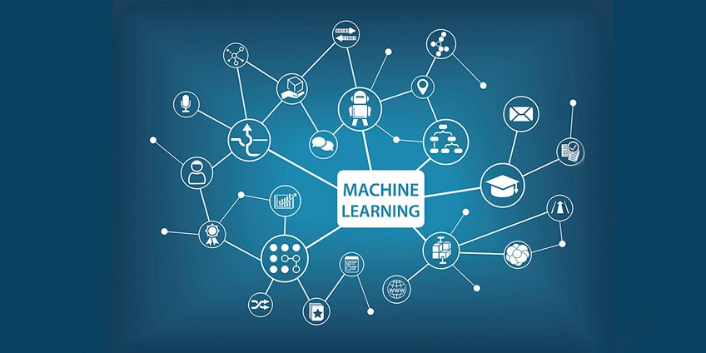
MACHINE LEARNING
Branch of Artificial Intelligence(AI).
ability of systems to learn from data without explicitly programmed
Makes computer more intelligent

Slide 3
LEARNING PROCESS

Slide 4


SOFTWARE USED
Anaconda
- Anaconda navigator
- Anaconda cloud
Tensorflow

Slide 5


OUR PROJECT
Data classification-prediction of diabetis
Data classification-prediction of wine quality
Data classification-type of animal

Slide 6
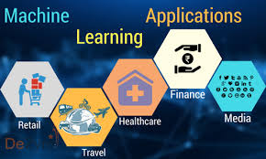

APPLICATIONS
Virtual personal assistance-google
Traffic prediction-map
Video surveillance
Search engine

Slide 7
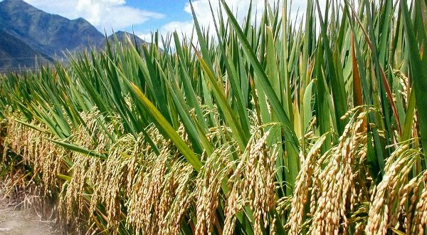
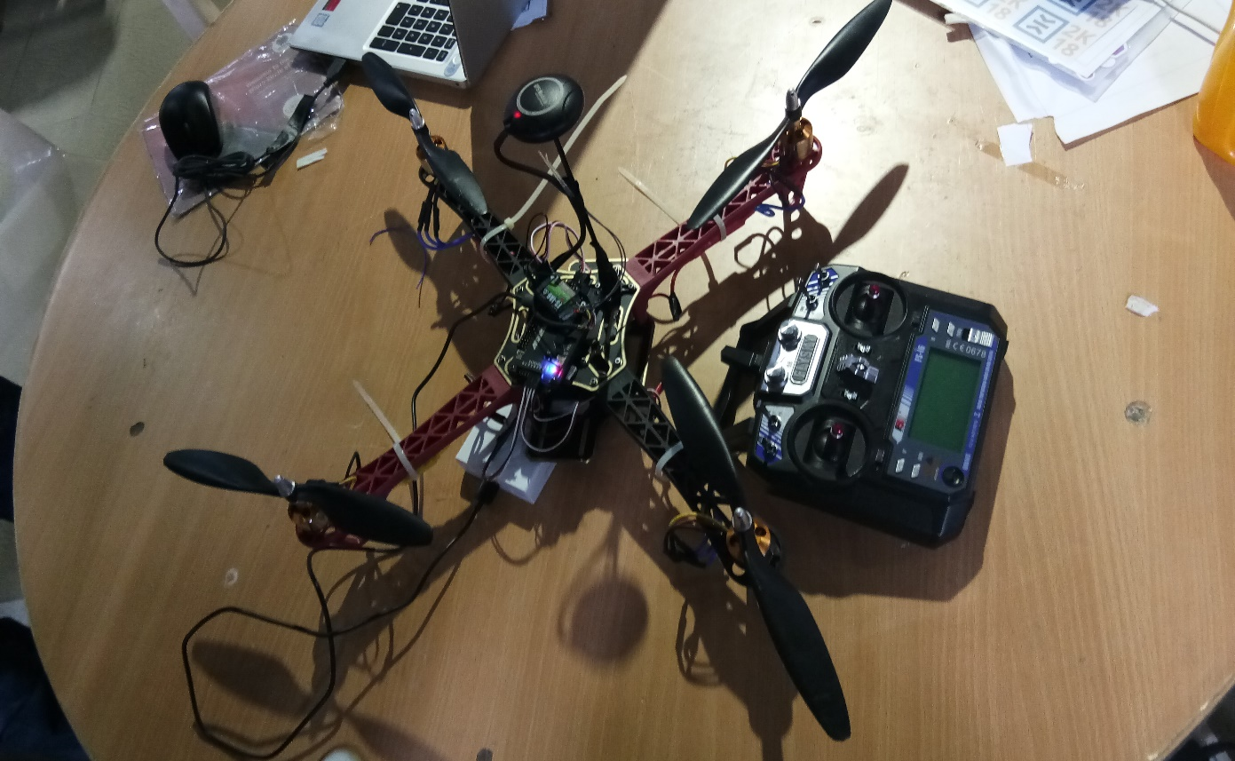
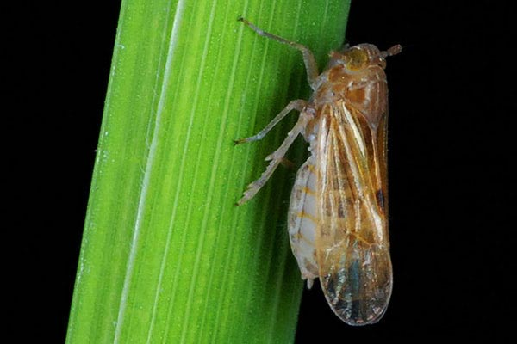
Automatic pesticide sprayer

Slide 8
THANK YOU

